Slide 1

PROJECT TITLE
Vials Counting Using Image Processing

Slide 2

Project Leadership
Bharani Kumar Depuru
CEO & Director at Innodatatics and Sponsor
https://www.linkedin.com/in/bharanikumardepuru/
PROJECT MENTORS -
Indira Kumar
Aniket Nandanwar

Slide 3
Project Members
Kaushiv Chaudhary
LinkedIn- linkedin.com/in/kaushivchaudhary

Slide 4

Contents
Business objective
Business Constraints
Project Architecture
Data collection and details
Image Annotation
Pre processing and Augmentation
Dataset Export and Model Selection
Model Training, Validation and Testing
Deployment
Notes:
Change

Slide 5
Project Overview and Scope
Business Problem: The Challenge is to design the counting system for syringes and vials that streamlines operations and mitigates the risk of human error , ultimately optimizing productivity and accuracy in the process.
Business Objective: Maximize efficiency and Minimize manual errors in inventory management.
Constraints: Minimize solution cost , Camera, Custom Dome Light Setup.
Success Criteria:
Business: Reduce manual effort by at least 10%.
ML: Achieve accuracy of at least 96%.
Economic: Achieve cost saving of at least $1M.

Slide 6
Project Overview and Scope
Project Scope
Design the system to be cost-effective, focusing on minimizing the overall solution cost.
Develop a vision-based counting system for syringes and vials.
Deploy the system in a real-world environment.
Provide user-friendly interfaces for monitoring and control.

Slide 7
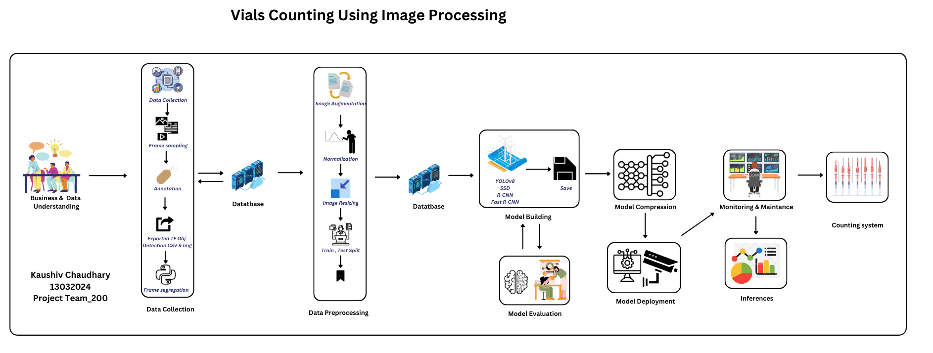
Project Overview and Scope

Slide 8
There are six stages of CRISP-ML(Q) Methodology
1.Business and data understanding
2.Data preparation
3.Model building
4.Model evaluation
5.Model deployment
6.Monitoring and maintenance
CRISP-ML(Q) Methodology

Slide 9
Technical Stacks
Python Programming
Roboflow
Google Colab
YOLO
Spyder
Streamlit
Flask

Slide 10
Data Collection and Understanding
Business Understanding
1. Conducted review of 10 research papers related to Counting system using Image Processing..
2. Gathering information from research papers
3. Building a Project Architecture based on that information.
Data Collection –
Gathered videos from YouTube.
Captured frames at 30 fps.
Stored all dataset in a drive.

Slide 11
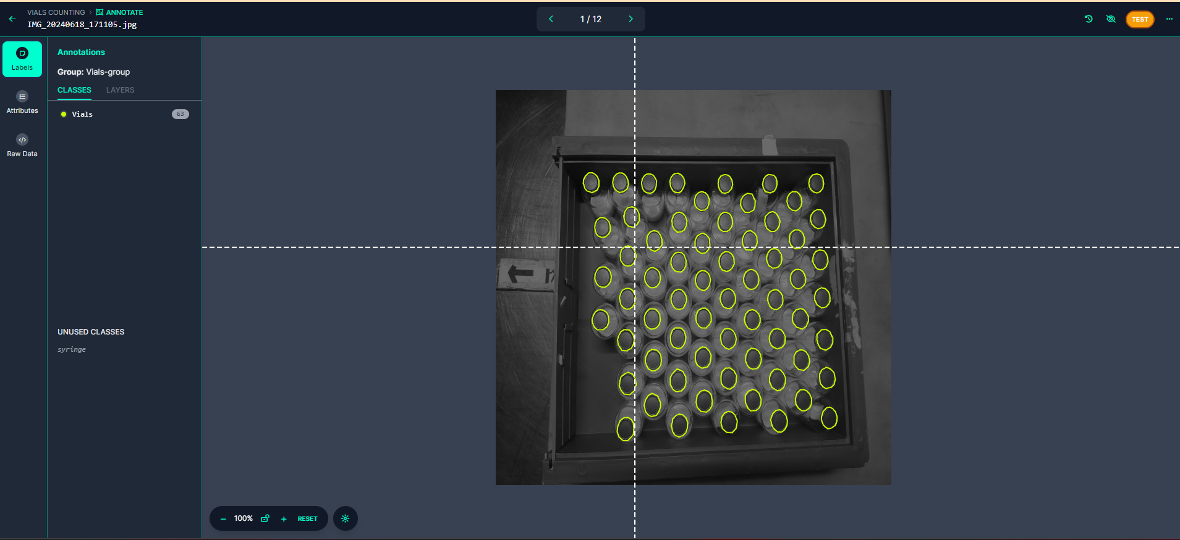
Image Annotation
TOOL USED – ROBOFLOW
1. Uploaded collected images for processing.
2. Created two classes: Vials And Syringes.
3. Annotated images using bounding boxes for classification.

Slide 12
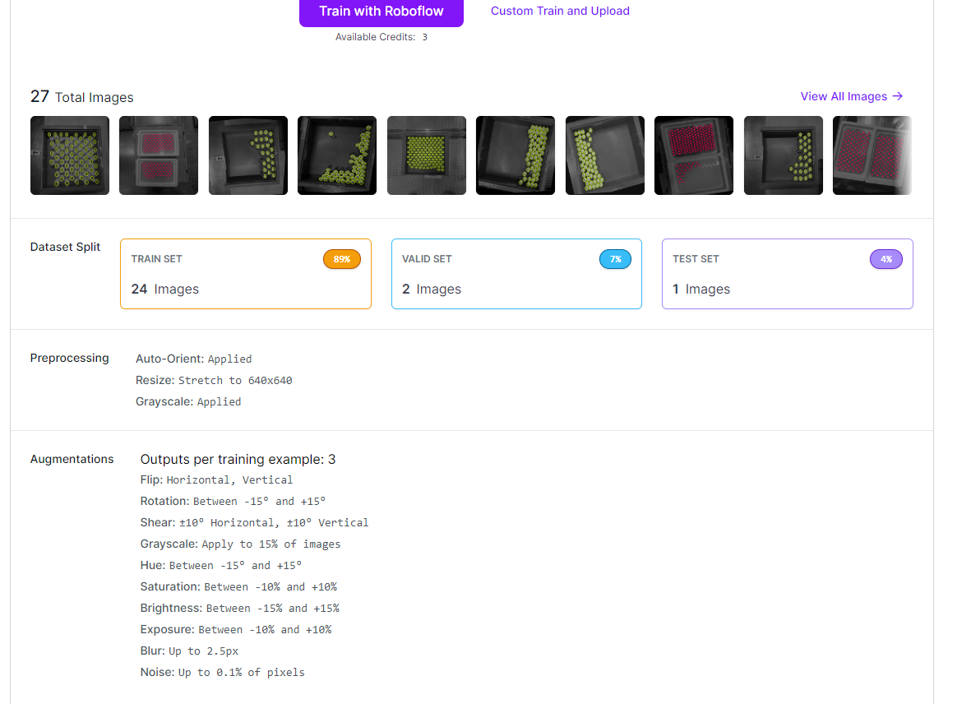
Data Preprocessing and Augmentation
Data preprocessing –
Applied auto orientation to images.
Resized images to 640 x 640 pixels.
Data Augmentation –
Flip – Horizontal
Rotation – Between -15⁰ and 15⁰
Brightness - Between -15⁰ and 15⁰
Exposure – Between -10% and 10%
Blur – Upto 2.5 px
Noise – upto 1.96% of pixel

Slide 13
Generating Dataset and Model Selection
Export Dataset –
Exported the generated dataset in YOLOv8 format for further processing and training.
Model Selection –
Multiclass Classification Model – YOLOv8

Slide 14
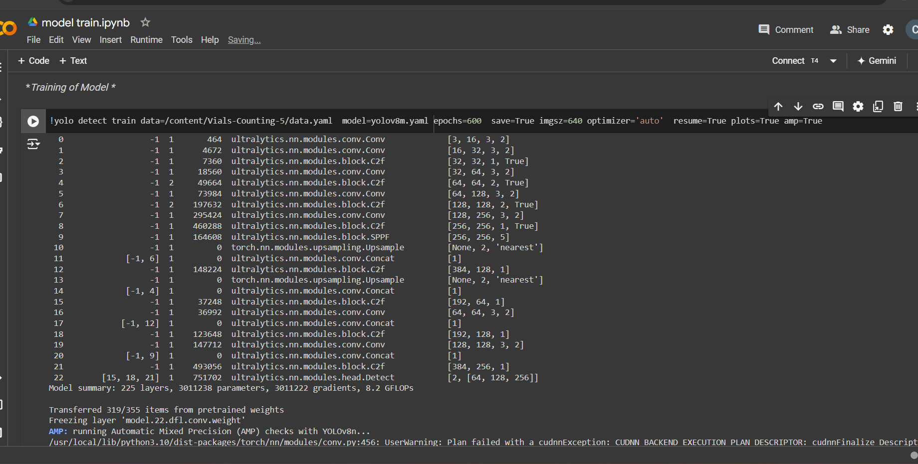
Model Training
Google colab T4 GPU was used as runtime server
Library use:
Ultralytics , Roboflow
Hyperparameter Tuning
epoch = 600, batch=6 , imgsz=640 , optimizer=‘auto’
best performing model best.pt was selected from weights
Model used for training: Yolov8m.yaml
Notes:
Change

Slide 15
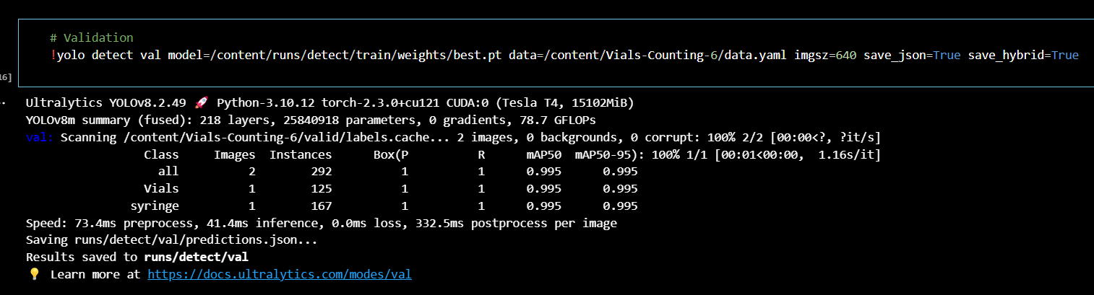
Model Validation
Validation was also done by using Ultralytics Yolov8 with mode=val , task = detect

Slide 16
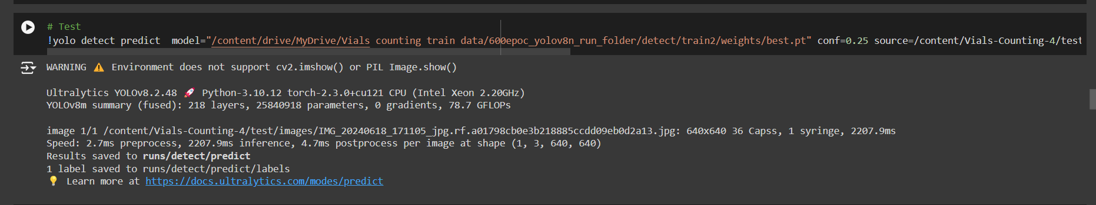
Model Testing
Yolov8 uses mode=predict to test on our trained model using best.pt file from training
Notes:
Keep observations

Slide 17
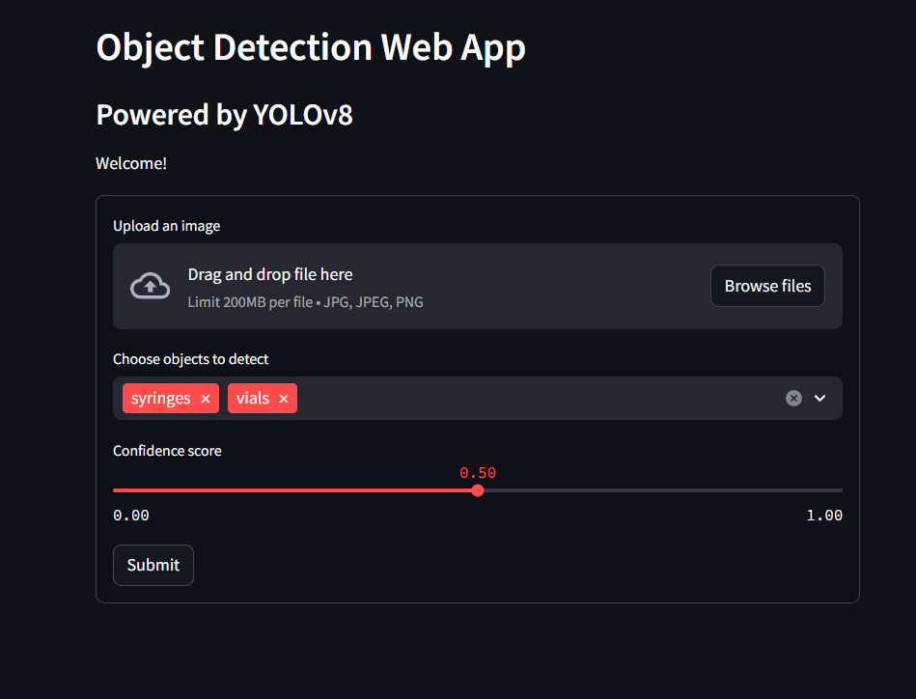
Model Deployment - StreamLit
Notes:
classification is the task of predicting a discrete class label. Regression is the task of predicting a continuous quantity.
What is classification techniques in machine learning?
The Classification algorithm is a Supervised Learning technique that is used to identify the category of new observations on the basis of training data. In Classification, a program learns from the given dataset or observations and then classifies new observation into several classes or groups.
What is regression techniques in machine learning?
Regression is a technique for investigating the relationship between independent variables or features and a dependent variable or outcome. It's used as a method for predictive modeling in machine learning, in which an algorithm is used to predict continuous outcomes.

Slide 18
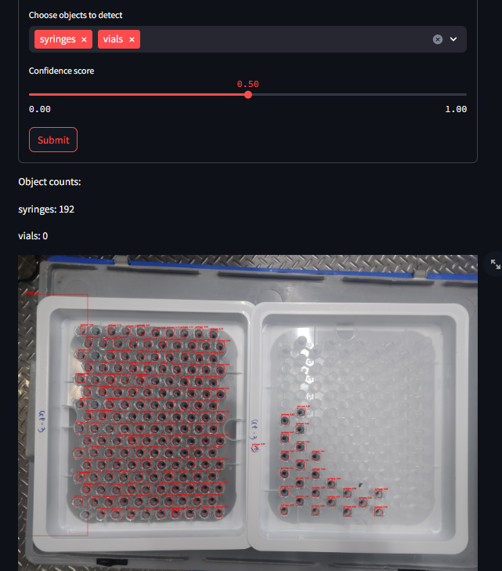
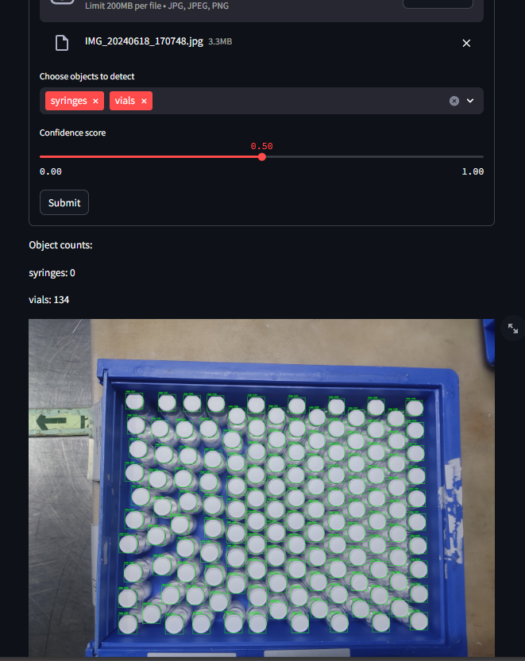
Screenshot of output

Slide 19
Challenges
Achieving real-time counting to keep up with the pace of operations without introducing significant latency.
Ensuring that the system is user-friendly and that employees can easily adapt to the new technology.
Thoroughly testing the system to ensure it meets the required accuracy and efficiency standards before full deployment.
Ensuring the camera and machine learning model can accurately detect and count syringes and vials in various orientations and under different lighting conditions.

Slide 20
Future Scopes
Adapt the system to count additional types of medical supplies beyond syringes and vials.
Utilize machine learning algorithms to predict inventory needs based on historical data and trends.
Explore ways to reduce hardware and maintenance costs through advancements in camera and lighting technology.
Implement eco-friendly practices in the system's design and operation to reduce its environmental impact.
Partner with international organizations to deploy the system in global markets.
Develop comprehensive training programs for staff to ensure efficient system use.
Continuously gather feedback from users to refine and improve the system.

Slide 21

Queries ?

Slide 22


